Slide 1
Master Artifact
VDS
Native Library
Andrew Pendleton
CX Design Systems
Core Product
Project

Slide 2
Verizon Design Systems
Executive Summary | Native Library
Strategic Themes
North Star
Leads
01
Architect, develop, and launch the VDS Native Library, a comprehensive suite of reusable, pre-built, and rigorously tested UI components for iOS (UIKit, SwiftUI) and Android (Jetpack Compose). This includes robust documentation, clear usage guidelines, theming capabilities, and direct support channels (e.g., Slack, office hours) ensuring seamless adoption and ongoing maintenance.
Bridge the gap for native application development (iOS: UIKit/SwiftUI; Android: Jetpack Compose) by providing a comprehensive, coded VDS component library.
This will empower native developers to achieve full parity with web VDS users, enabling the creation of efficient, consistent, reliable, accessible, scalable, and high-quality customer experiences on all native platforms.
Andrew Pendleton
Workstream Lead
Andrew Pendleton
Initiative Lead
Mobile
Fios
FWA
Scale
02
Customer Impact
Native developers will experience a significant boost in productivity by using pre-built, VDS-compliant components, reducing boilerplate code and rework. This leads to faster feature delivery, fewer visual defects, and enhanced UI consistency. They gain robust tools to build more accessible applications and can focus on solving unique user problems rather than reinventing common UI elements, fostering better collaboration.
KPIs Impacted
P*Q
Customer Satisfaction
Digital Interaction Score
$-
Incr. Revenue
$-
Call Volume Opt.
03
Business Impact
Overall Conversion
Prospect Conversion
$-
Handle Time Opt.
$8.1M
Other Benefit Value
By empowering native developers, VDS Native Library will deliver superior, more consistent brand experiences across all Verizon apps, enhancing customer satisfaction and trust. It accelerates time-to-market for critical features, improves overall product quality and accessibility, and reduces redundant development costs. This directly increases VDS adoption, maximizing its ROI and strategic value.
Other Cost Savings
$TBDM
Total 2026 Capex + Opex
Incremental Request

Slide 3
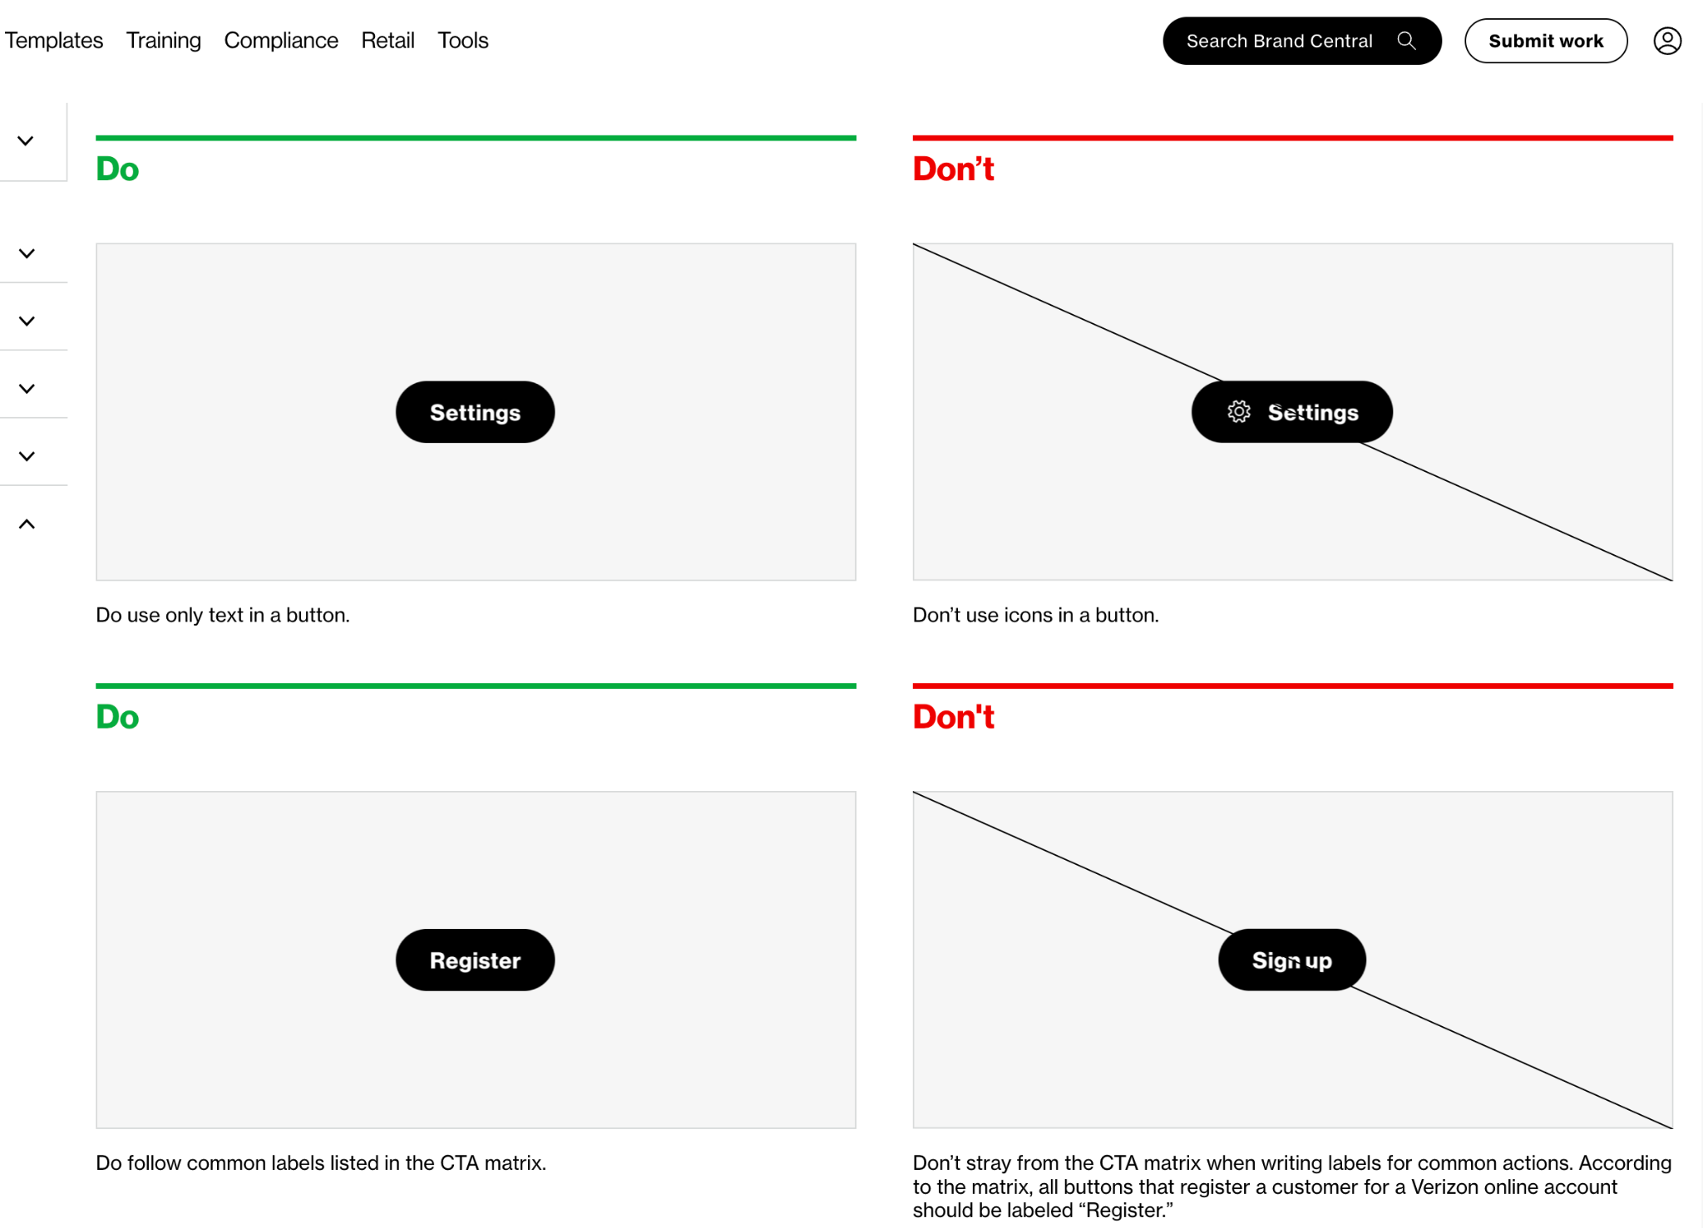
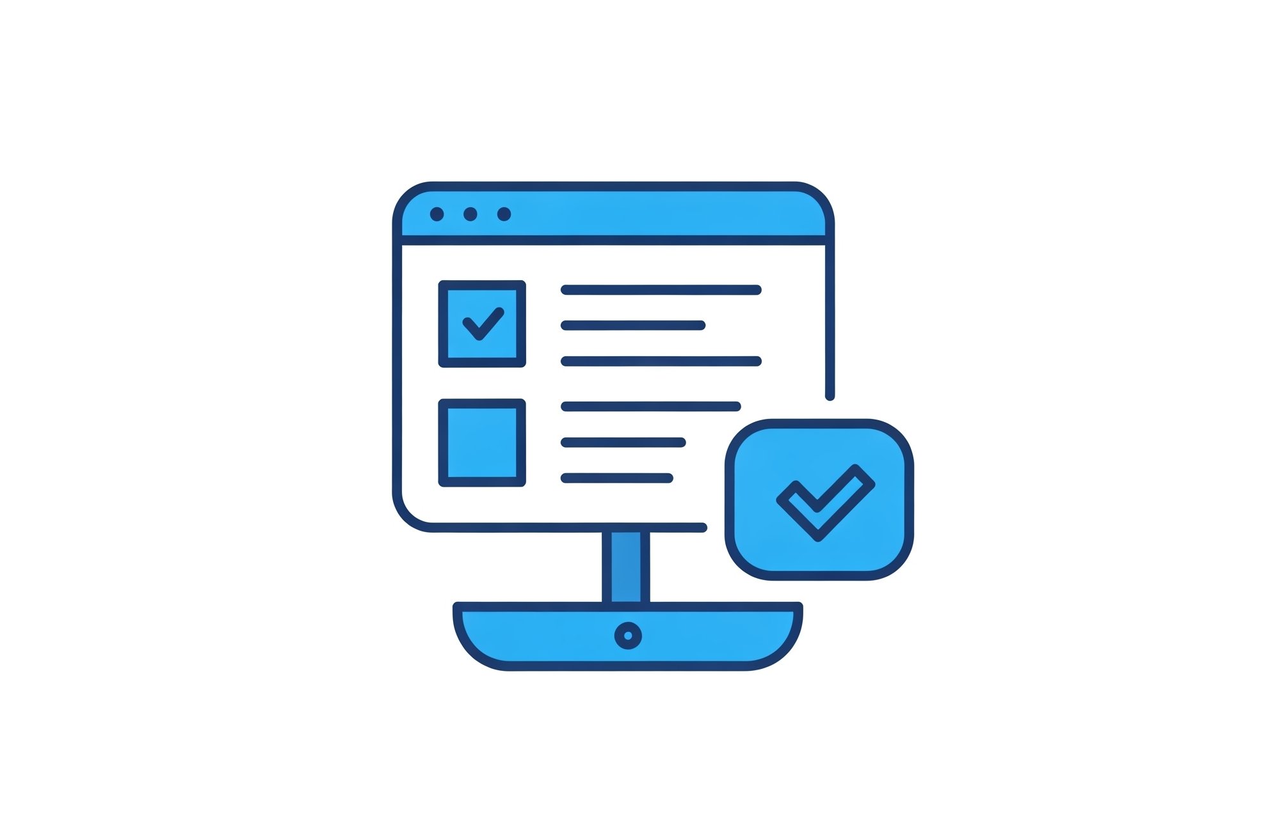

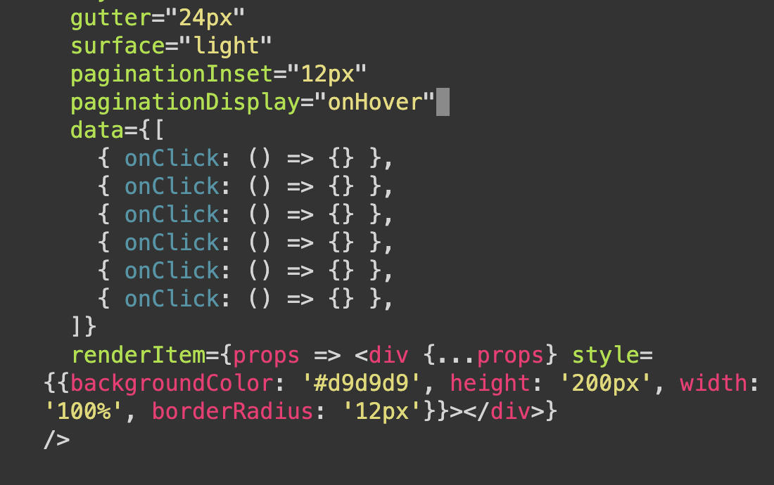
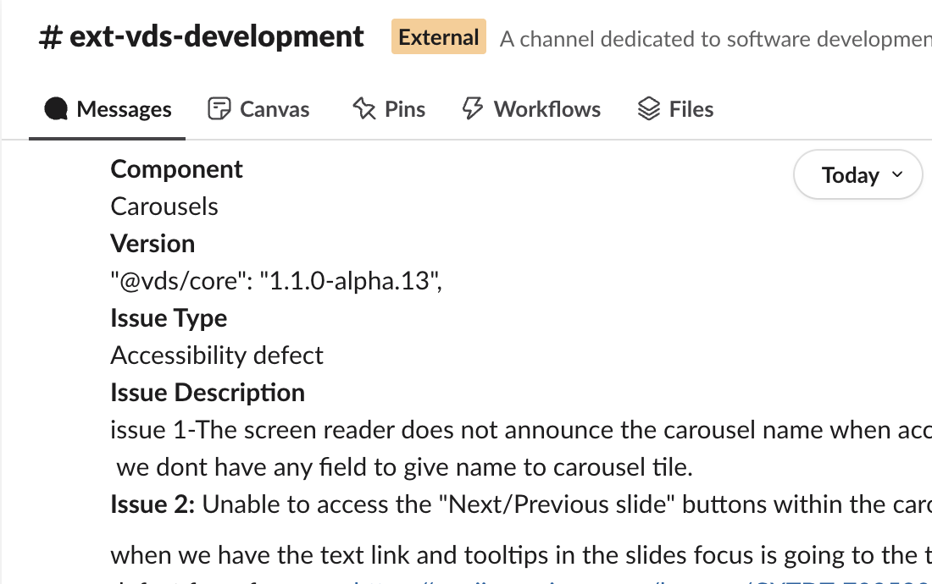
Verizon Design Systems
Journey Map | Native Library
Documentation & Guidelines
Our VDS Native Library will feature comprehensive documentation and clear guidelines, serving as the single source of truth for both designers and developers. These accessible resources detail native principles, component APIs, platform-specific usage (iOS/Android), accessibility standards, and contribution models. The impact is immediate: teams are empowered with actionable knowledge, speeding up onboarding and ensuring consistent, high-quality, and compliant native experiences.
Native Figma Components
Designers creating native app experiences will benefit from a hybrid VDS Figma approach.
Existing VDS web components will be used where suitable for native, ensuring cross-platform consistency. This is complemented by a new, dedicated VDS Native Figma library for any uniquely mobile UI components, variants, and states.
This strategy, mainly for designers (devs for reference), speeds up native design, ensures UI fidelity, and improves handoff.
Native Coded Components (x2)
Developers will primarily utilize our production-ready VDS Coded Components for iOS (SwiftUI/UIKit) and Android (Jetpack Compose).
These easily installable, rigorously tested, and performant libraries are built with accessibility and theming at their core.
The impact is a dramatic reduction in native development time and effort, as these reusable building blocks minimize custom code, ensure consistency, improve quality, and free up developers to focus on core business logic.
Support & Feedback Both designers and developers will benefit from our dedicated VDS Native support channels, including a responsive Slack community and VDS team office hours.
With clear processes for bug reporting, feature requests, and feedback collection, we ensure continuous improvement.
This provides a crucial safety net, unblocking users quickly and fostering a collaborative partnership where feedback directly shapes a more robust, user-centric native library.

Slide 4

VDS Native Library
VDS Product: Functional Expansion
Workstream Lead: Andrew Pendleton
Initiative Lead: Andrew Pendleton
Northstar
Scope
Results
The Idea
Problem & Opportunity
Currently, native app developers (iOS/Android) cannot leverage VDS coded components, unlike web teams. This critical gap hinders their efficiency, creates design inconsistencies, impacts product quality, and slows feature delivery. It results in duplicated effort, potential UI/UX divergence from the core brand, and a diminished ability to rapidly iterate on native customer experiences.
Proposed Solution
Architect, develop, and launch the VDS Native Library, a comprehensive suite of reusable, pre-built, and rigorously tested UI components for iOS (UIKit, SwiftUI) and Android (Jetpack Compose). This includes robust documentation, clear usage guidelines, theming capabilities, and direct support channels (e.g., Slack, office hours) ensuring seamless adoption and ongoing maintenance.
Customer Impact
Native developers will experience a significant boost in productivity by using pre-built, VDS-compliant components, reducing boilerplate code and rework. This leads to faster feature delivery, fewer visual defects, and enhanced UI consistency. They gain robust tools to build more accessible applications and can focus on solving unique user problems rather than reinventing common UI elements, fostering better collaboration.
Business Impact
By empowering native developers, VDS Native Library will deliver superior, more consistent brand experiences across all Verizon apps, enhancing customer satisfaction and trust. It accelerates time-to-market for critical features, improves overall product quality and accessibility, and reduces redundant development costs. This directly increases VDS adoption, maximizing its ROI and strategic value to the business.
Our North Star is to bridge the gap for native application development (iOS: UIKit/SwiftUI; Android: Jetpack Compose) by providing a comprehensive, coded VDS component library.
This will empower native developers to achieve full parity with web VDS users, enabling the creation of efficient, consistent, reliable, accessible, scalable, and high-quality customer experiences on all native platforms.

Slide 5
Expected Results
Northstar
Scope
Results
Expansion: VDS Native Library
KPI’s Impacted- Section 1
CX Excellence
❎ | Customer Satisfaction (CSAT) |  |  |  | ⬜ | Rep Interaction Score (RIS) |  |  |  | ⬜ | Churn Reduction
⬜ | 3-day Resolve |  |  |  | ❎ | Digital Interaction Score (DIS)
Revenue Growth
⬜ | Service Product Revenue |  |  |  |  | ❎ | Overall Conversion
⬜ | Service Product Revenue |  |  |  |  | ❎ | Prospect Conversion
Operational Efficiency
⬜ | Call Volume Optimization (CVO) |  |  |  |  |  | ⬜ | Average Handle Time (AHT)
⬜ | Retail Transaction Time |  |  |  |  |  | ❎ | Other Cost Savings
Financial Scope & Targets (P*Q)- Section 2
Benefit Value Estimates
Incremental Revenue $_______ Call Volume Optimization $________ Handle Time Optimization $_______ Other Benefit Value $_8.1M_______ (please explain)
Investment Planning - Section 3 (CXO IPG to complete this section)
Capital Investment Estimates
GTS Labor estimate $__________ Non-GTS estimate $__________
Operating Expense for Initiative (Incremental) CXO Operating Cost (OPEX) $________ CXO Incremental Headcount ________

Slide 6
2026 Capex + Opex Incremental
Northstar
Scope
Results
Xxx (i.e. Koenders, Butler etc.) | xxx (i.e. CX, Experience Product, Digital Channel etc.)
Status | Opex ID | Product Area | EMR (see notes) | Initiative Name | Vendor Name | Description | Budget
C | Opex-xxx | Assisted Experience | Contracted Services | <Name> | <Vendor> | <Description> | $XXX.XX
N | New
C | Continue
S | Stop
Notes:
Expense Management Record (EMR) Categories
Advertising and Promotion
Contracted Services
Direct Costs
Full Time Labor
HR and Training
IT and Technology Contracts
Other Operating Costs
Overhead Costs
Professional Services Fees
Sales Incentives
Temporary Labor
Travel and Internal Events

Slide 8
Master Artifact
Initiative Name
Submitter Name
Band 5 Team Name
Core Product
Project

Slide 9
2026 CXO Planning
For CX Strategy Use - Do Not Fill Out
Workstream Name | Initiative Name TEMPLATE
Northstar:
Strategic Themes
Journey Map
01
Program goal
Key activity
Key activity
Key activity
Key activity
High-level program goal description/objective
02
Program goal
Key activity
Key activity
Key activity
Key activity
High-level program goal description/objective
03
Program goal
High-level program goal description/objective
Expected Outcomes
Expected Results
04
Program goal
Name of KPI
Name of KPI
$XX
Incr. Revenue
$XX
Call Volume Opt.
High-level program goal description/objective
05
Program goal
Name of KPI
Name of KPI
$XX
Handle Time Opt.
$XX
Other Benefit Value
High-level program goal description/objective
Name of KPI
Name of KPI
$XXM
Total 2026 Capex + Opex
Incremental Request

Slide 10
Initiative Name
Workstream Name
Workstream Lead: Name
Initiative Lead: Name
Template
Northstar
Scope
Results
Strategic Themes
[EXAMPLE] Customer need or problem being solved
Giving customers visibility and creating end to end ownership on issues that we cannot resolve on the initial interaction
Customer need or problem is being solved
[What will be unlocked for the customer or business?]
Customer need or problem being solved
[What will be unlocked for the customer or business?]
Customer need or problem being solved
[What will be unlocked for the customer or business?]
Customer need or problem being solved
[What will be unlocked for the customer or business?]
[Northstar statement - Ambition Here]

Slide 11
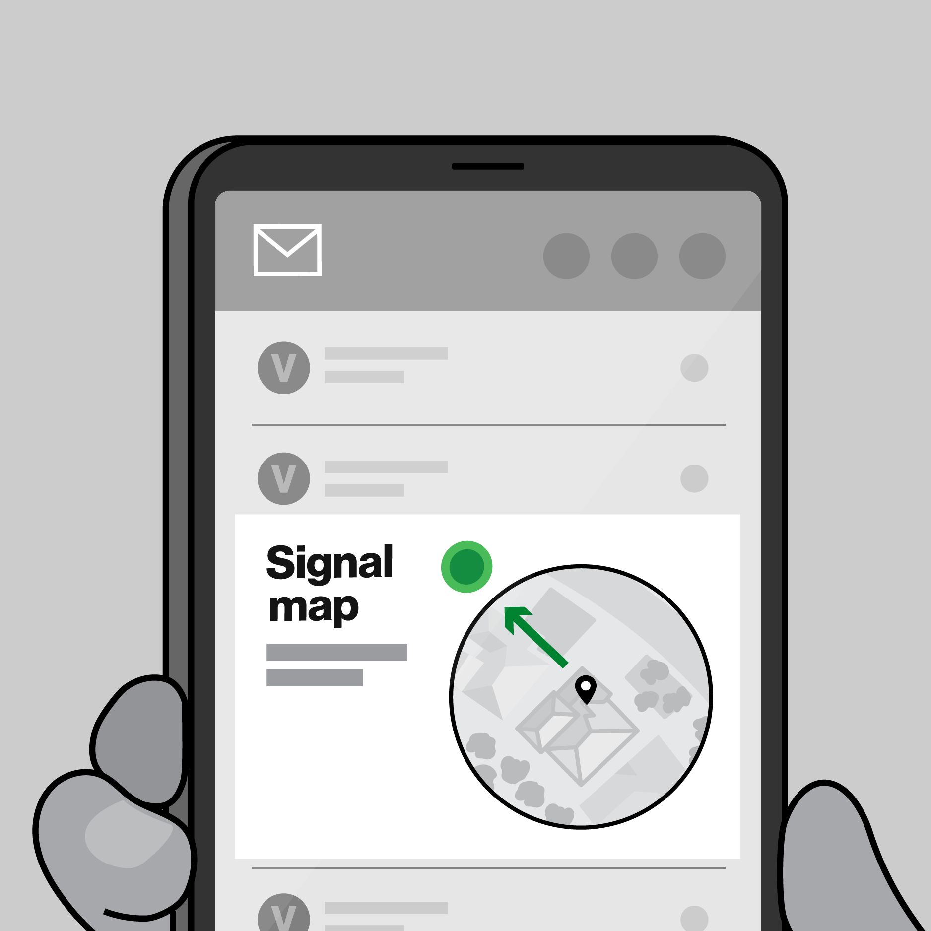
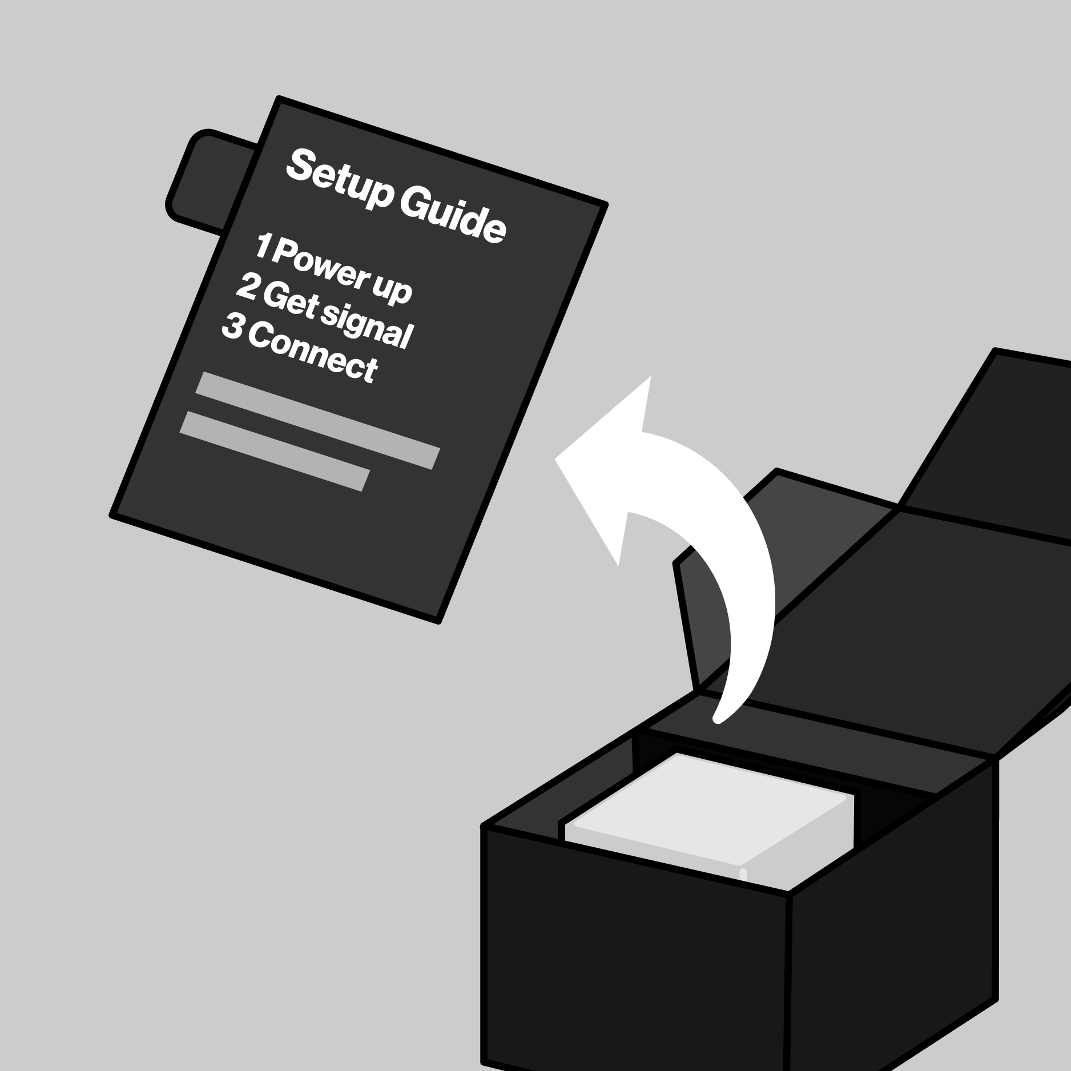


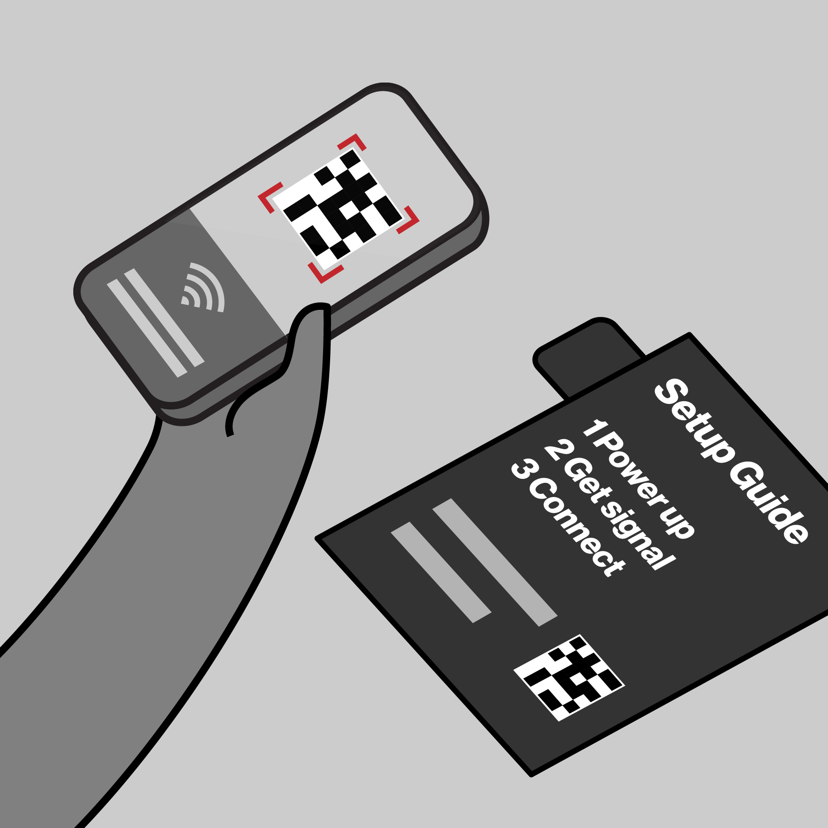
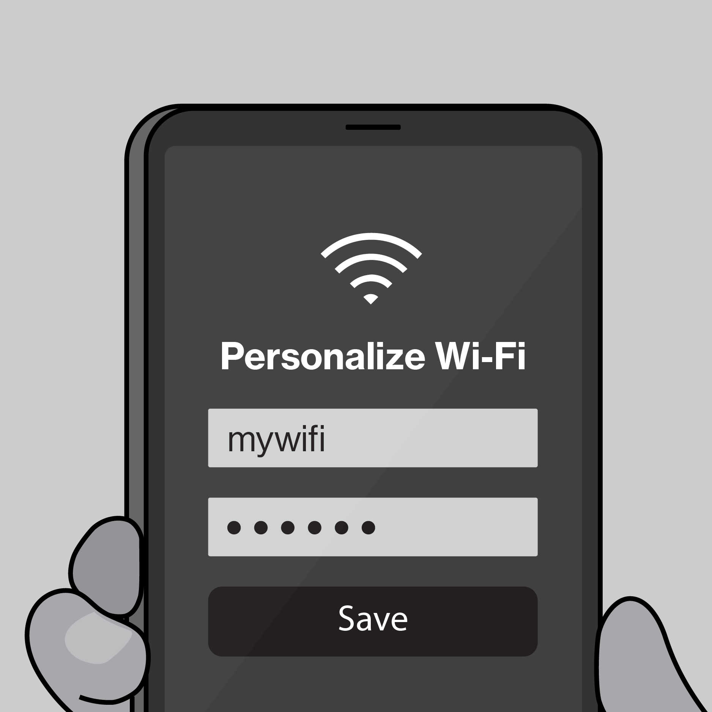

Template
Northstar
Scope
Results
CX Workstream Name
Journey Map Template
Illustrative Only
Key Customer Actions
Description customer objectives and actions
Key Customer Actions
Description customer objectives and interactions
Key Customer Actions
Description customer objectives and interactions
Key Customer Actions Description customer objectives and interactions
Key Customer Actions
Description customer objectives and interactions
Key Customer Actions
Description customer objectives and interactions
Key interactions
Key Interactions w/ Verizon
Key Interactions w/ Verizon
Key Interactions w/ Verizon
Key Interactions w/ Verizon
Key Interactions w/ Verizon
Key Interactions w/ Verizon

Slide 12
Expected Results
Template
Northstar
Scope
Results
CX Workstream Name
KPI’s Impacted- Section 1
CX Excellence
⬜ | Customer Satisfaction (CSAT) |  |  |  | ⬜ | Rep Interaction Score (RIS) |  |  |  | ⬜ | Churn Reduction
⬜ | 3-day Resolve |  |  |  | ⬜ | Digital Interaction Score (DIS)
Revenue Growth
⬜ | Service Product Revenue |  |  |  |  | ⬜ | Overall Conversion
⬜ | Service Product Revenue |  |  |  |  | ⬜ | Prospect Conversion
Operational Efficiency
❎ | Call Volume Optimization (CVO) |  |  |  |  |  | ⬜ | Average Handle Time (AHT)
⬜ | Retail Transaction Time |  |  |  |  |  | ⬜ | Other Cost Savings
Financial Scope & Targets (P*Q)- Section 2
Benefit Value Estimates
Incremental Revenue $_______ Call Volume Optimization $________ Handle Time Optimization $_______ Other Benefit Value $________ (please explain)
Investment Planning - Section 3 (CXO IPG to complete this section)
Capital Investment Estimates
GTS Labor estimate $__________ Non-GTS estimate $__________
Operating Expense for Initiative (Incremental) CXO Operating Cost (OPEX) $________ CXO Incremental Headcount ________
Notes:
Add in a grey box over area that business should not complete for clarity, re-org details

Slide 13
2026 Capex + Opex Incremental
Northstar
Scope
Results
Xxx (i.e. Koenders, Butler etc.) | xxx (i.e. CX, Experience Product, Digital Channel etc.)
Status | Opex ID | Product Area | EMR (see notes) | Initiative Name | Vendor Name | Description | Budget
C | Opex-xxx | Assisted Experience | Contracted Services | <Name> | <Vendor> | <Description> | $XXX.XX
N | New
C | Continue
S | Stop
Notes:
Expense Management Record (EMR) Categories
Advertising and Promotion
Contracted Services
Direct Costs
Full Time Labor
HR and Training
IT and Technology Contracts
Other Operating Costs
Overhead Costs
Professional Services Fees
Sales Incentives
Temporary Labor
Travel and Internal Events

Slide 14
2026 Opex Only
Northstar
Scope
Results
Xxx (i.e. Koenders, Butler etc.) | xxx (i.e. CX, Experience Product, Digital Channel etc.)
Status | Opex ID | Product Area | EMR (see notes) | Initiative Name | Vendor Name | Description | Budget
C | Opex-xxx | Assisted Experience | Contracted Services | <Name> | <Vendor> | <Description> | $XXX.XX
N | New
C | Continue
S | Stop
Notes:
Expense Management Record (EMR) Categories
Advertising and Promotion
Contracted Services
Direct Costs
Full Time Labor
HR and Training
IT and Technology Contracts
Other Operating Costs
Overhead Costs
Professional Services Fees
Sales Incentives
Temporary Labor
Travel and Internal Events

Slide 15
Example
2026 Planning Artifacts
Journey Map Example
Post-Sale / Pre-Setup
Taylor gets a confirmation email to set her up for success.
1. Unbox
On opening the box, Taylor sees a simple 1-2-3 set of instructions for setup
2. Find a spot
Using what she learned in-store, she chooses a spot to plug-in.
3. Activate internet
When the light turns solid white she’s setup. If help is needed, she refers to the 5G Compass in MVA.
Download / Open MVA
If Taylor wants to personalize her network, she can scan the QR code or enter the URL to deep link in My Verizon app.
Personalize internet
Once she has the My Verizon app open, there are a variety of personalizations and settings that she can change.
Key interactions
Confirmation email / Get ready page
Register
Download MVA
5G signal map + compass
Setup guide
Device
Power adapter
LED status
Wi-Fi name/password
5G signal map + compass
Setup guide
My Verizon app
Authentication
My Verizon app
Set Wi-Fi name/password
Connect devices

Slide 16
Master Artifacts
Due 5/19

